Slide 1
The Framework for Improving Critical Infrastructure Cybersecurity version 1.1
The NIST framework
By: Rahel Sileshi
31/05/2024

Slide 2
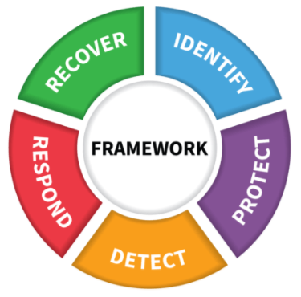
Objective and Agenda
Objective: Convey Cybersecurity Framework use, while explaining features added in Version 1.1
About NIST and its frameworks
Users
Attributes, Components, & Approaches
Framework Focus Areas
Update Process

Slide 3
National Institute of Standards and Technology
About NIST
Agency of U.S. Department of Commerce
NIST’s mission is to develop and promote measurement, standards, and technology to enhance productivity, facilitate trade, and improve the quality of life.
Federal, non-regulatory agency around since 1901
Cybersecurity since the 1970s
Computer Security Resource Center – csrc.nist.gov

Slide 4
NIST frameworks
Risk Management Framework (RMF)
Workforce Framework (NICE)
Privacy Engineering framework (PEF)
Cyber physical systems (CPS) framework
Cybersecurity Framework (CSF)
The cybersecurity framework organizes and communicates about cybersecurity improvements

Slide 5
























Cybersecurity Framework Users
Notes:
And also:
Cisco
Motorola
IBM
Microsoft
Dell
CA Technologies
Emblem Health
AdvaMed
Merck
Kaiser Permanente
Sempra Energy
Boeing

Slide 6
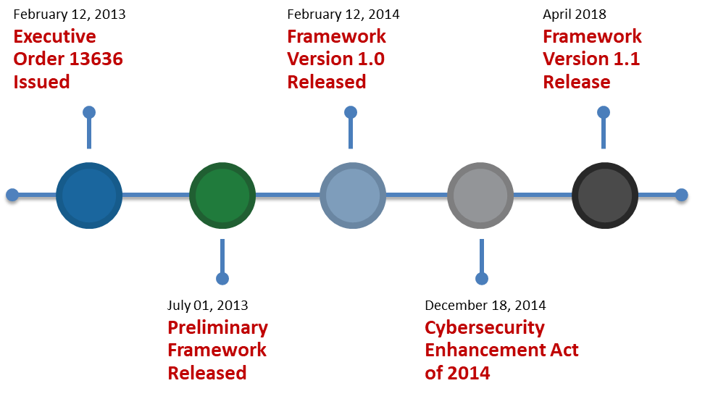
Eras of Cybersecurity Framework
6

Slide 7
Version 1.0 and 1.1 Are Fully Compatible
Additions, including new categories and subcategories, do not invalidate existing V1.0 uses or work products
Component | Version 1.0 | Version 1.1 | Comments
Functions | 5 | 5
Categories | 22 | 23 | Added a new category in ID.SC – Supply Chain
Subcategories | 98 | 108 | Added 5 subcategories in ID.SC Added 2 subcategories in PR.AC Added 1 subcategory each to PR.DS, PR.PT, RS.AN Clarified language in 7 others
Informative References | 5 | 5

Slide 8
Key Framework Attributes
Common and accessible language
Understandable by many professionals
It’s adaptable to many technologies^{1.1}, lifecycle phases^{1.1}, sectors and uses
Meant to be customized
It’s risk-based
A Catalog of cybersecurity outcomes
Does not provide how or how much cybersecurity is appropriate
Take advantage of great pre-existing things
It’s a living document
Enable best practices to become standard practices for everyone
Can be updated as technology and threats change
Evolves faster than regulation and legislation
Can be updated as stakeholders learn from implementation

Slide 9
The CSF is for organizations
Of any size, in any sector in (and outside of) the critical infrastructure.
That already has a mature cyber risk management and cybersecurity program.
That doesn’t yet have a cyber risk management or cybersecurity program
Needing to keep up-to-date managing risks, and facing business or societal threats.

Slide 10
Cybersecurity Framework Components
Framework Core
Framework Implementation Tiers
Framework Profile
Aligns industry standards and best practices to the Framework Core in a particular implementation scenario
Supports prioritization and measurement while factoring in business needs
Cybersecurity activities and informative references, organized around particular outcomes
Enables communication of cyber risk across an organization
Describes how cybersecurity an organization manages risk and degree the risk management practices exhibit key characteristics

Slide 11
CSF Core Components
 | Function
What processes and assets need protection? | Identify | Understandable by everyone Applies to any type of risk management Defines the entire breadth of cybersecurity Spans both prevention and reaction
What safeguards are available? | Protect
What techniques can identify incidents? | Detect
What techniques can contain impacts of incidents? | Respond
What techniques can restore capabilities? | Recover

Slide 12
CSF Core Components
 | Function | Category
What processes and assets need protection? | Identify | Asset Management
 |  | Business Environment
 |  | Governance
 |  | Risk Assessment
 |  | Risk Management Strategy
 |  | Supply Chain Risk Management^{1.1}
What safeguards are available? | Protect | Identity Management, Authentication and Access Control^{1.1}
 |  | Awareness and Training
 |  | Data Security
 |  | Information Protection Processes & Procedures
 |  | Maintenance
 |  | Protective Technology
What techniques can identify incidents? | Detect | Anomalies and Events
 |  | Security Continuous Monitoring
 |  | Detection Processes
What techniques can contain impacts of incidents? | Respond | Response Planning
 |  | Communications
 |  | Analysis
 |  | Mitigation
 |  | Improvements
What techniques can restore capabilities? | Recover | Recovery Planning
 |  | Improvements
 |  | Communications

Slide 13
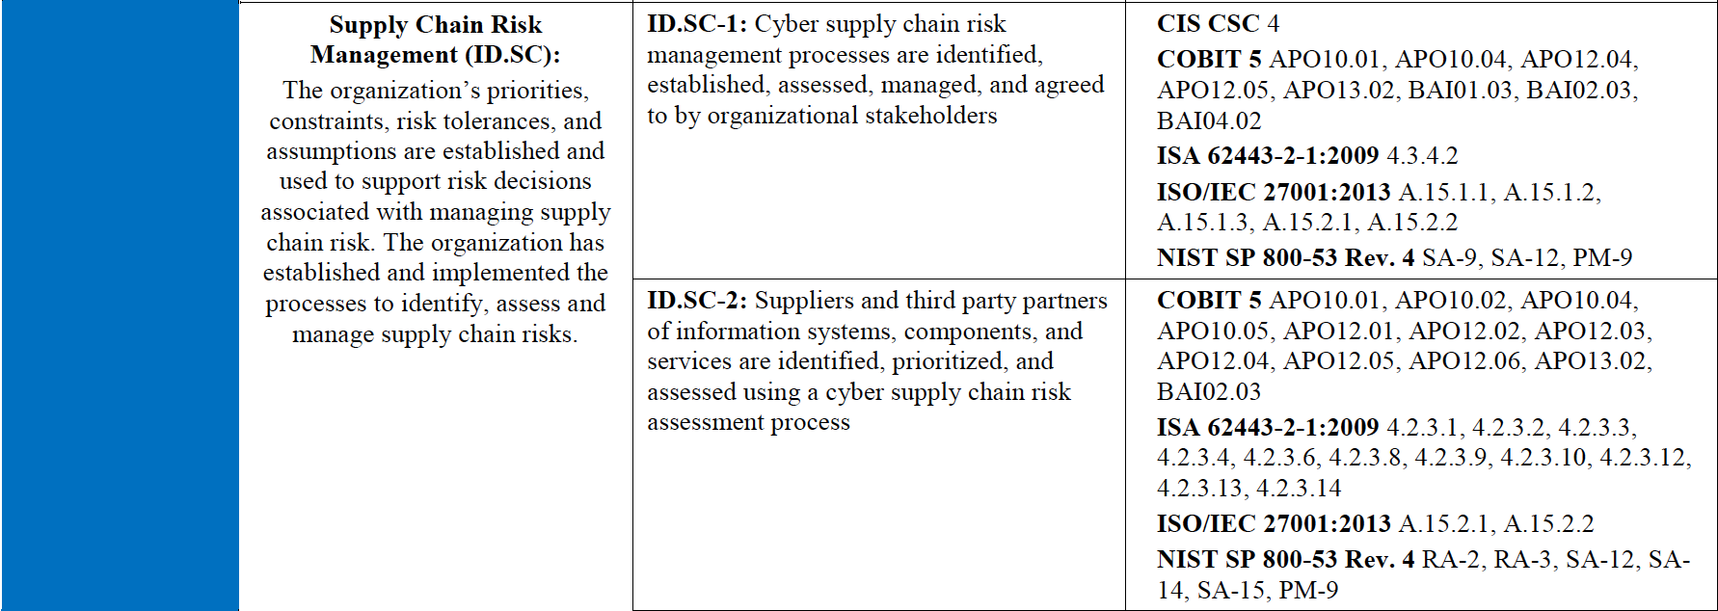

Core – Example^{1.1}

Slide 14
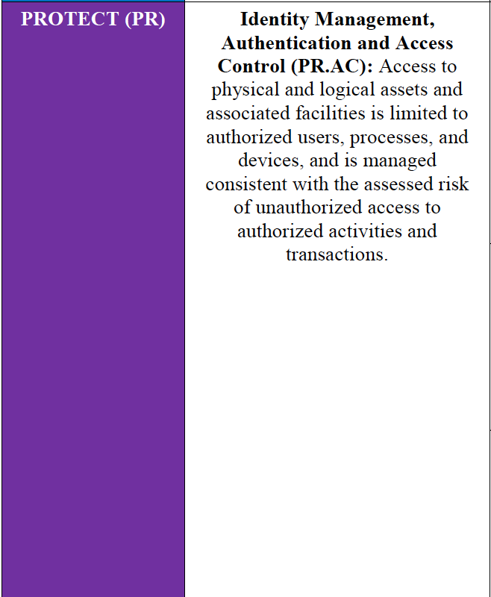
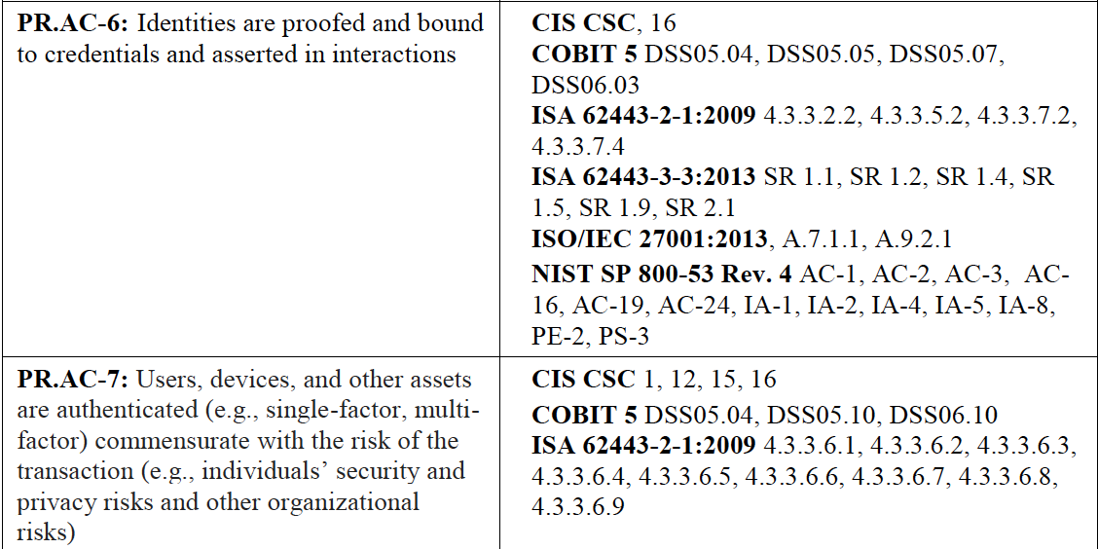

Core – Example^{1.1}
Cybersecurity Framework Component

Slide 15
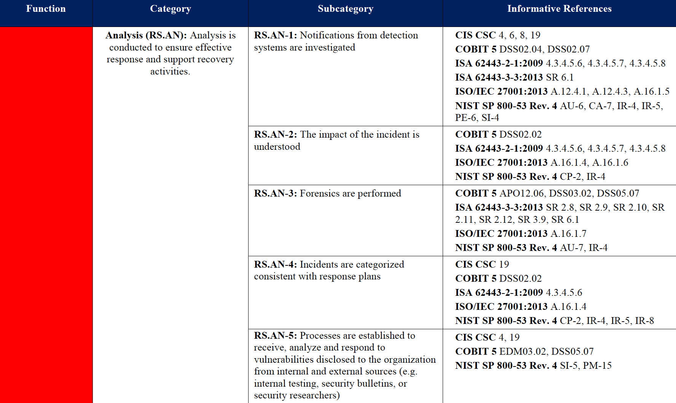

Core – Example
Cybersecurity Framework Component
1.1

Slide 16
Implementation Tiers
 | 1 | 2 | 3 | 4
 | Partial | Risk Informed | Repeatable | Adaptive
Risk Management Process | The functionality and repeatability of cybersecurity risk management
Integrated Risk Management Program | The extent to which cybersecurity is considered in broader risk management decisions
External Participation | The degree to which the organization benefits my sharing or receiving information from outside parties
16

Slide 17
CSF Profile
A customization of the Core for a given sector, subsector, or organization
A fusion of business/mission logic and cybersecurity outcomes
Identify
Protect
Detect
Respond
Recover
An alignment of cybersecurity requirements with operational methodologies
A basis for assessment and expressing target state
A decision support tool for cybersecurity risk management

Slide 18
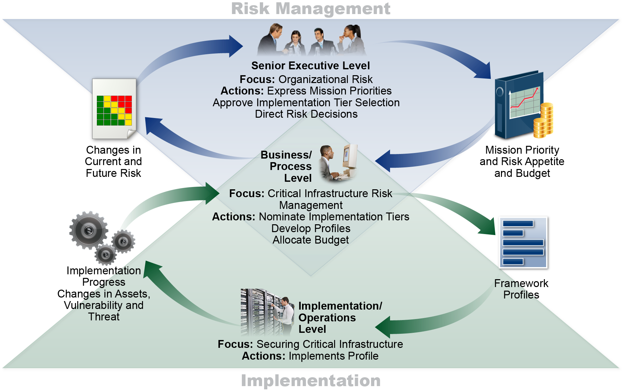
Notional Information and decision flow within organization
1.1
1.1

Slide 19
How to use the framework
The framework is a key part of its systematic process for identifying, assessing, and managing cybersecurity risk.
It is not designed to replace existing processes; an organization can use its current process and overlay it onto the Framework to determine gaps in its current cybersecurity risk approach and develop a roadmap to improvement.
Using the Framework as a cybersecurity risk management tool, an organization can determine activities that are most important to critical service delivery and prioritize expenditures to maximize the impact of the investment.

Slide 20
Framework Seven-Step Process Gap Analysis Using Framework Profiles
Step 1: Prioritize and Scope
The organization identifies its business/mission objectives and high-level organizational priorities.
With this information, the organization makes strategic decisions regarding cybersecurity implementations and determines the scope of systems and assets that support the selected business line or process
Step 2: Orient
Once the scope of the cybersecurity program has been determined for the business line or process, the organization identifies related systems and assets, regulatory requirements, and overall risk approach. The organization then consults sources to identify threats and vulnerabilities to those systems and assets.

Slide 21
Framework Seven-Step Process Gap Analysis Using Framework Profiles
Step 3: Create a Current Profile
indicating which Category and Subcategory outcomes from the Framework Core are currently being achieved.
Step 4: Conduct a Risk Assessment
Step 5: Create a Target Profile
When used in conjunction with an Implementation Tier, characteristics of the Tier level should be reflected in the desired cybersecurity outcomes^{1.1}
Step 6: Determine, Analyze, and Prioritize Gaps
Step 7: Implementation Action Plan

Slide 22
Supply chain risk management(SCRM)
Supply chains begin with the sourcing of products and services and extend from the design, development, manufacturing, processing, handling, and delivery of products and services to the end user
Cyber SCRM is the activities necessary to manage cybersecurity risk associated with external parties.
More specifically, cyber SCRM addresses both the cybersecurity effect an organization has on external parties and the cybersecurity effect external parties have on an organization.

Slide 23
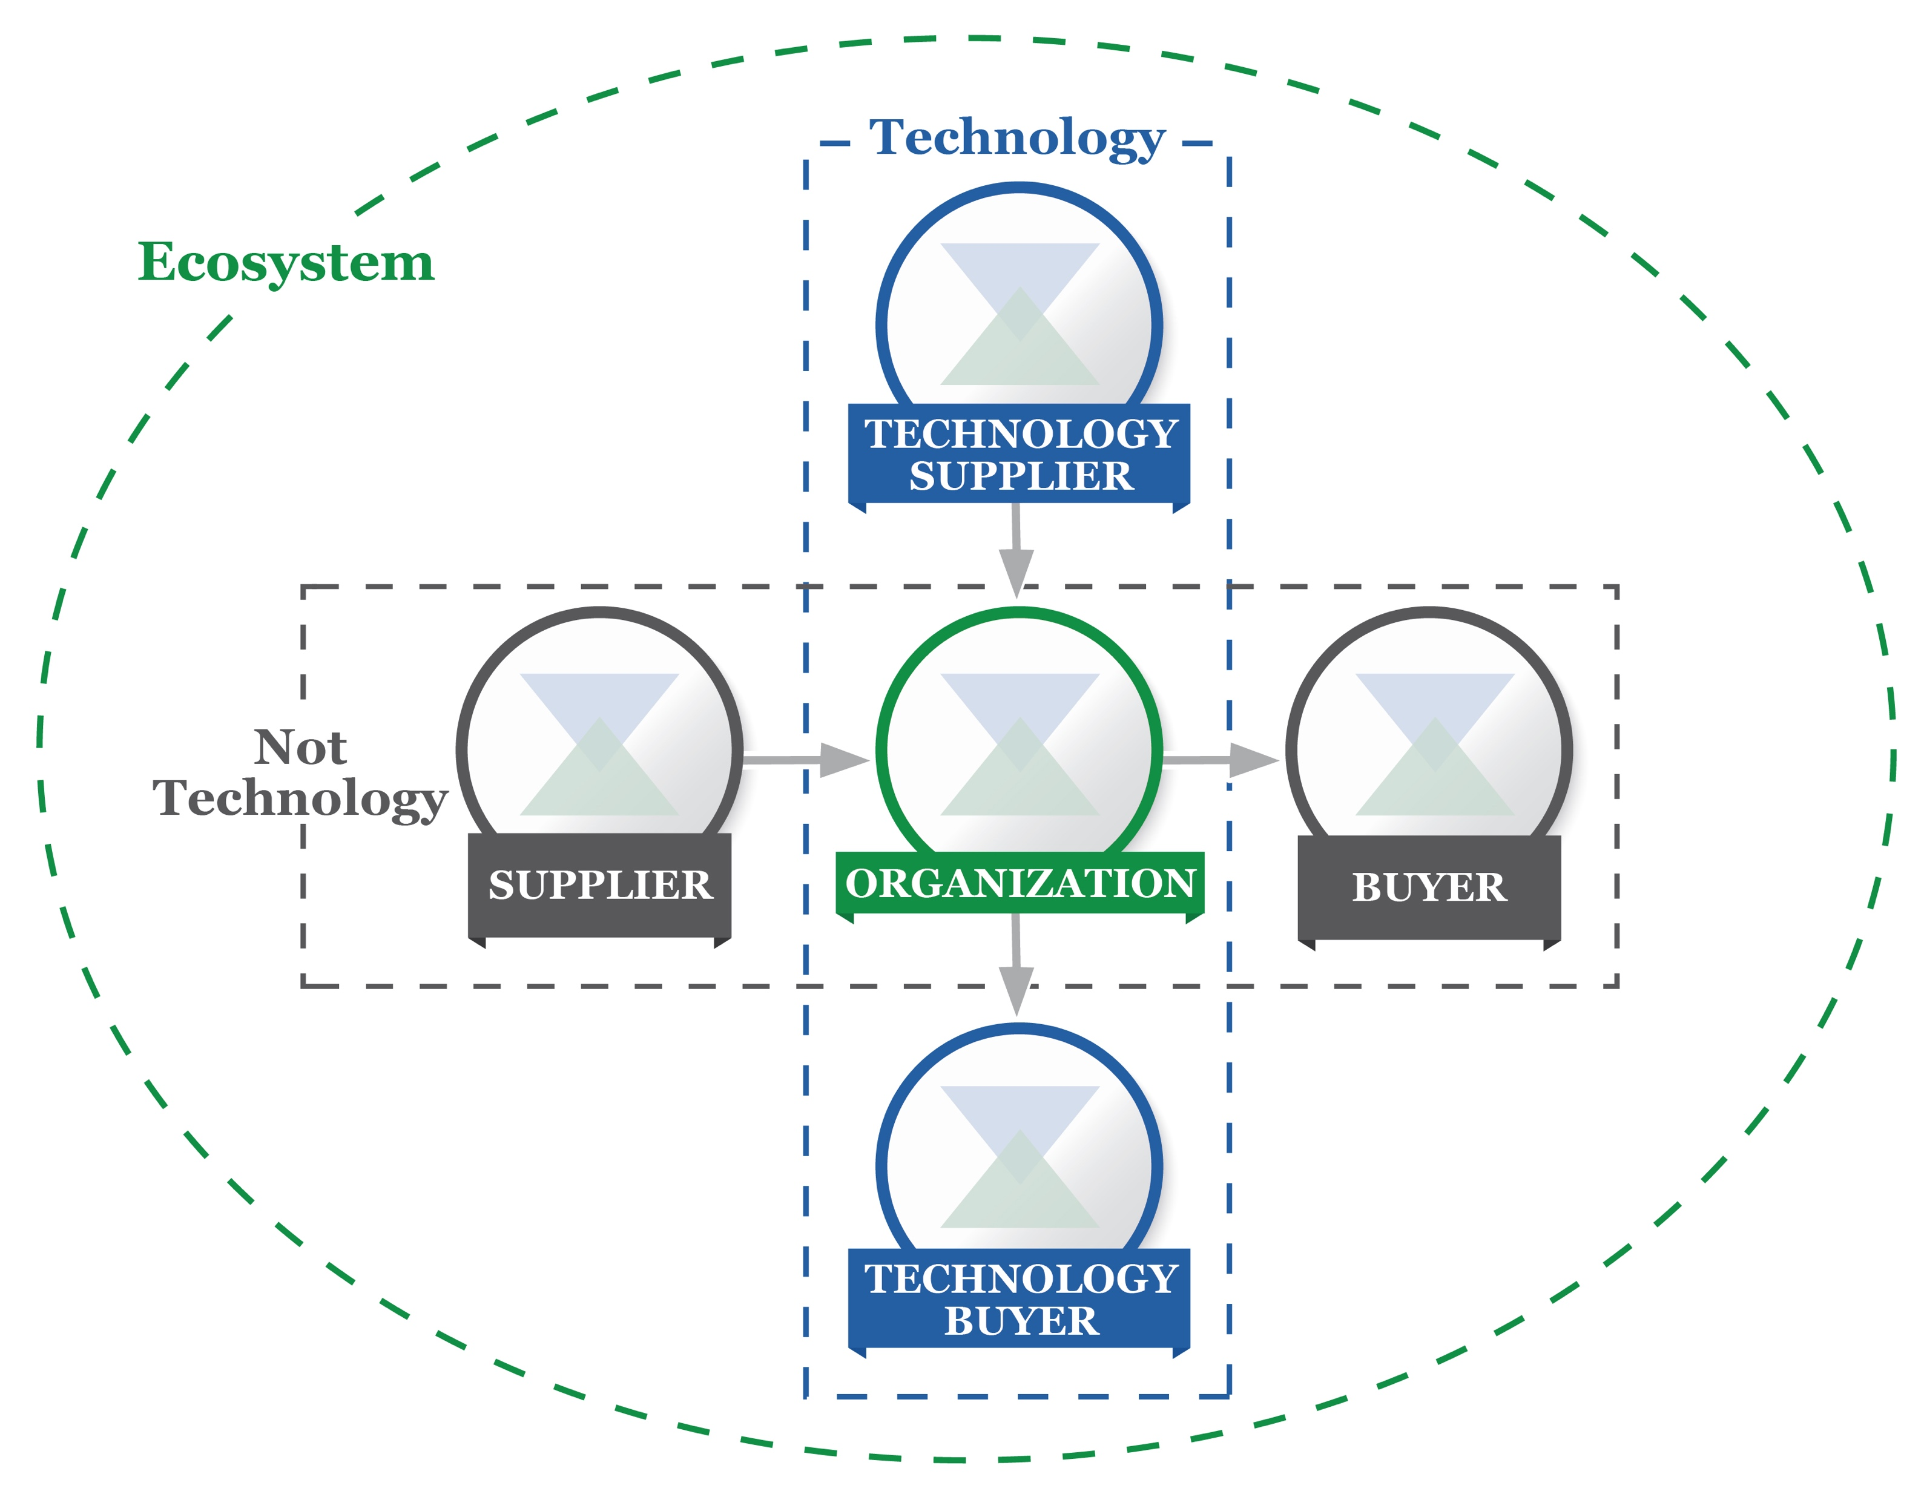
Cyber SCRM Taxonomy^{1.1}
Simple Supplier-Buyer model
Technology minimally includes IT, ICS, CPS, IoT
Applicable for public and private sector, including not-for-profits
Aligns with Federal guidance Supply Chain Risk Management Practices for Federal Information Systems and Organizations (Special Publication 800-161)

Slide 24
Self-Assessing Cybersecurity Risk^{1.1}
The framework helps measure and assign values to the risks considering the cost and benefits of steps taken
The better an organization can measure the risks, cost, and benefits of cybersecurity strategies the more it is effective the more rational, effective, and valuable its cybersecurity approach and investments will be

Slide 25
How the framework Core support self-assessment
See how different CSF operations influence Target Implementation Tiers
Evaluate the organizations approach to CSRM by determining current implementation Tiers
Prioritize CS outcomes by developing target profiles.
See the degree to which specific steps the CS gives desired outcomes by assessing the current profiles
Measuring the degree of implementation of control catalogs listed in informative references

Slide 26
Thank you!!

